Slide 1
HUDs Office of Special Needs Assistance Programs (SNAPS) Updates
Karen DeBlasio, Division Director, Office of Special Needs Assistance Programs (SNAPS)
June 13, 2023

Slide 2
Today’s Agenda
SNAPS Budget Overview
Continuum of Care Program Updates
Emergency Solutions Grants/ESG CV Allocations Updates
NSPIRE Updates

Slide 3
Budget Homeless Assistance Grants (HAG) and Other Spending
 | FY2022 Appropriated | FY2023 Appropriated | FY2023 Appropriated
Homeless Assistance Grants
Emergency Solutions Grants | $290 | $290 | $290
Continuum of Care | $2,757 | $3,102 | $3,298
Domestic Violence Grants* | $52 | $52 | $52
New Permanent Supportive Housing Unit Development Program | - | $75 | -
Youth Demonstration & youth TA | $82 | $82 | $82
Youth System Improvement | $25 | - | -
HMIS | $7 | $7 | $27
Total Homeless Assistance Grants | $3, 213 | $3,633 | $3,749
Other Homeless Funds
HUD-VASH, including Tribal HUD-VASH | $55 | $58 | -
* The Domestic Violence Grants are awarded to projects that will serve survivors of domestic violence. These grants are awarded through HUD's CoC Program Competition process.
Notes:
$27 million in HMIS funds
$12 million for Homeless Management Information System (HMIS), data analysis,
and technical assistance; and
o $15 million to assist victim service providers to use comparable databases that
comply with HUD’s data collection, reporting, privacy, and security requirements
and empower victim service providers and CoCs to better use and analyze their data to inform services for survivors of domestic violence, dating violence, sexual assault, stalking or human trafficking

Slide 4
FY22 SNAPS Competition Updates
FY22 CoC & FY22 Unsheltered/Rural Special NOFO awards:
All FY22 competition announcements have been made.
We are working to get grants under grant agreement.
FY22 YHDP Round 7 NOFO is open and closing on June 27, 2023.

Slide 5
FY23 CoC NOFO- Registration Update
FY23 CoC Registration closed on March 2, 2023
SNAPS will be sending a list serv email out any day letting CoCs know updated Grant Inventory Worksheets (GIWs) have been posted to HUD.gov
Collaborative Applicants are responsible for reviewing the GIW and completing a GIW change form if there are any additions or edits.

Slide 6
FY23 ESG Allocation Updates
Build America, Buy America (BABA) requirements
The Act requires a “buy America” preference:
All iron and steel used in projects are produced in the United States; and
All manufactured products used in HUD-funded projects are produced in the United States; and
All construction materials are manufactured in the United States.
Language has been added to FY22 ESG grant agreements to reflect these new requirements:
The Recipient must comply with the requirements of the Build America, Buy America (BABA) Act, 41 USC 8301 note, and all applicable rules and notices, as may be amended, if applicable to the Recipient’s infrastructure project. Pursuant to HUD’s Notice, “Public Interest Phased Implementation Waiver for FY 2022 and 2023 of Build America, Buy America Provisions as Applied to Recipients of HUD Federal Financial Assistance” (88 FR 17001), any funds obligated by HUD on or after the applicable listed effective dates, are subject to BABA requirements, unless excepted by a waiver.
*Note that BABA requirements do not apply to funds allocated under the Robert Stafford Disaster Relief and Emergency Assistance Act*
Notes:
FY2023 CPD Formula Allocation letters have been emailed to recipients
Field offices are working on grant agreements now

Slide 7
ESG CV- Program Updates
All ESG CV funds must be expended by September 30, 2023
This includes funds from the first and second allocations;
Does NOT include funds received through reallocation in 2022; reallocated funds must be spent by June 30, 2024
Notice CPD-22-06 also provided more flexibility in the September 2023 deadline by providing communities an additional 3 months to expend administration and HMIS funds; these funds must be expended by December 31, 2023
As of last week- over 80% of ESG CV recipients were at least 66% drawn
Notes:
The Sept. 2021 deadline has come and gone and HUD worked with recipients who did not meet the deadline and recently sent letters out recapturing approximately $16 million. These funds will be reallocated to recipients who met the deadline and have spent at least 30% of their allocation.
This was not meant to be punitive and will NOT impact your “regular” ESG allocation. This was done to shift money to places that have exceeded the deadline so it will continue to be spent in the local area.

Slide 8
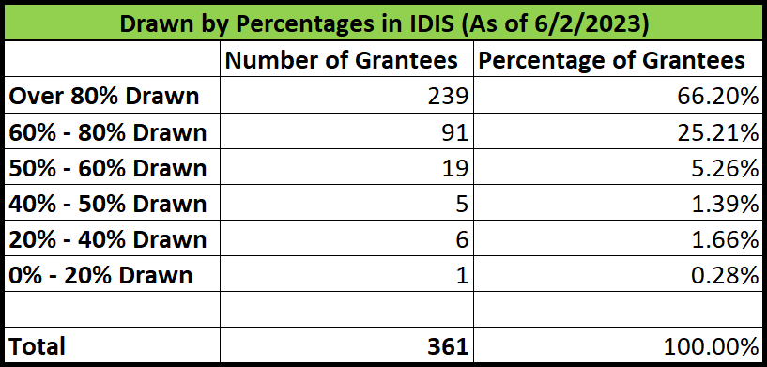
ESG-CV Grants Status Report
Notes:
20 more 80% drawn, 8 more 60-80, 4 more 50-60% 0-20 only one left!

Slide 9
ESG-CV Grants Status Report
$86 million not committed in IDIS
Draws across the country in the past week totaled $11.8 million
52 ESG-CV recipients drew funds in the past week.
51 ESG-CV recipients have not drawn funds in over 90 days.
36 recipients are behind on quarterly reports
Notes:
$2 million committed in last month, last month was $24.5 million drawn

Slide 10
ESG-CV Grants Status Report
Draw rates have been down over the last few months
Assess your progress to determine if you are on target to fully expend funds by the September 30, 2023 deadline.
Project the HMIS and Admin funds needed for closeout (e.g., for final reporting, reconciling IDIS, etc.), which need to be expended by December 31, 2023.
If you have concerns about not meeting the deadline, please reach out now for technical assistance.

Slide 11
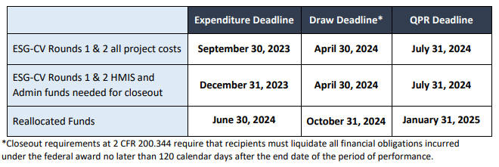
ESG CV Closeout Deadlines

Slide 12
ESG-CV Grants – Closeout Process
The SNAPS Office will be coming out with detailed guidance and training for recipients on closing out ESG-CV grants
Recipients that have fully drawn their ESG-CV grant can close out their QPR reporting.
Guidance is posted in SAGE and on the HUD Exchange instructing recipients how to submit their final QPRs. ESG-CV Reporting Office Hours in September 2022 goes through the QPR closeout process as well.

Slide 13
A Grant is ready for closeout when…
Recipient expended and drew all grant funds or returned any remaining funds)
All activities are eligible and were completed
3. Recipient submitted final QPR for completed activities, and HUD determined the report is satisfactory
4. Recipient expended all program income received during POP
5. No open audits or monitoring findings related to grant remain
6. Other responsibilities under the grant agreement and applicable laws and regulations appear to have been carried out

Slide 14
ESG CV Final QPR Submission
Submit when following conditions are met:
The funding for recipients’ ESG-CV-funded projects have ended (i.e., clients will no longer be served with ESG-CV funding);
The recipient has fully expended all ESG-CV funding (i.e., no more ESG-CV costs will be incurred); and
The recipient has fully drawn down all ESG-CV funding (i.e., the final draw of ESG-CV funding has been completed in IDIS).

Slide 15
National Standards for the Physical Inspection of Real Estate (NSPIRE)
New standards HUD will use to assess whether housing meets minimum quality standards and can be assisted with HUD funds
NSPIRE aligns multiple HUD programs to a single set of inspection standards so that the same expectations of housing quality can be achieved across HUD programs
Timeline:
January 2023- Notice of Intent to update inspection standards
March 2023-Request for comment on proposed changes
May 2023- Final NSPIRE Rule published
July 1 2023- Effective date (some HUD programs are exempted from 7/1 date)
October 1 2023- Effective date for CoC and ESG programs
Notes:
On May 10th, 2023, HUD published updates to the standards that it will use to assess whether housing meets minimum quality standards and may be assisted with HUD funds. These standards are known as the National Standards for the Physical Inspection of Real Estate (NSPIRE).
CoCs and ESG recipients should begin preparing for inspections to follow the NSPIRE standards as of October 1st, 2023. Additional guidance to assist CoC and ESG programs in this transition is forthcoming. While SNAPS develops additional guidance, CoCs may review the resources listed below.
NSPIRE Final Rule
NSPIRE website
The minimum standards established in 24 CFR 5.703 of the Final Rule will apply to housing funded with CoC and ESG Program funds beginning on October 1, 2023.

Slide 16
National Standards for the Physical Inspection of Real Estate (NSPIRE) cont’d
NSPIRE Inspection Types:
Self- inspections- done by property owners/management; done once a year
NSPIRE Inspections- done by contract inspectors and PHAs; done periodically (1-3 years)
NSPIRE Plus Inspections- done by HUD Federal or contract inspectors; done as requested or when triggered by poor conditions.
SNAPS is working on guidance specific to CoC and ESG programs; until further guidance is released, our offices suggests reviewing the NSPIRE final rule and website to become familiar with requirements.
NSPIRE Final Rule
NSPIRE website

Slide 17
SNAPS List Servs
Stay up to date on HUD’s Special Needs Assistance Programs (SNAPS) news and updates for grantees and interested stakeholders:
Sign up for SNAPS Competition Information through HUD.gov
Sign up for SNAPS Program Information through HUD.gov
Sign up for SNAPS Technical Assistance Information through HUD Exchange

Slide 18
Questions?

